Slide 1

Edges Scale
Join our newsletter for FREE lessons
www.schoolofatelierarts.com

Slide 2
Whenever two different values or colors meet, they create an edge.

Slide 3
When a value transitions from dark to light quickly, we call that a “sharp edge”.

Slide 4
When a value transitions from dark to light slowly, we call that a “soft edge”.

Slide 5
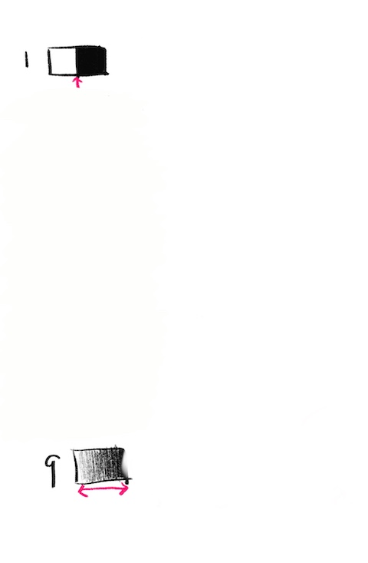
Sometimes the edge is very crisp, like this.

Slide 6
The value goes from light to dark super quickly.

Slide 7
Sometimes the transition between two values is very fuzzy.

Slide 8
It transitions from light to dark sooooo slowly that it is hard to tell exactly where the edge even is!

Slide 9
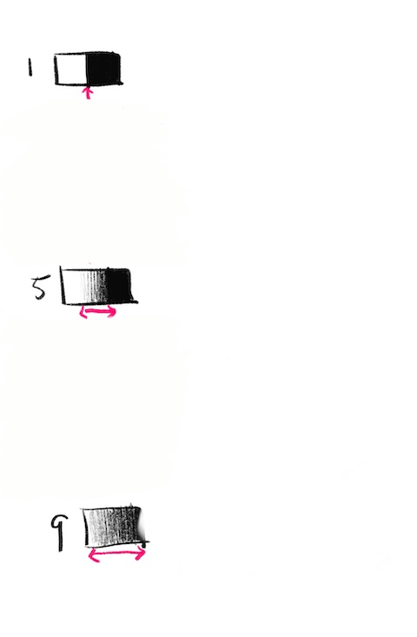
Sometimes the edge is in between crisp and fuzzy.

Slide 10
We know the edge is in the middle but it is still a little fuzzy.

Slide 11
In fact, there are MANY kinds of edges all the way from super crisp to super fuzzy.

Slide 12
Artists use hard and soft edges to create different effects in their drawings.

Slide 13
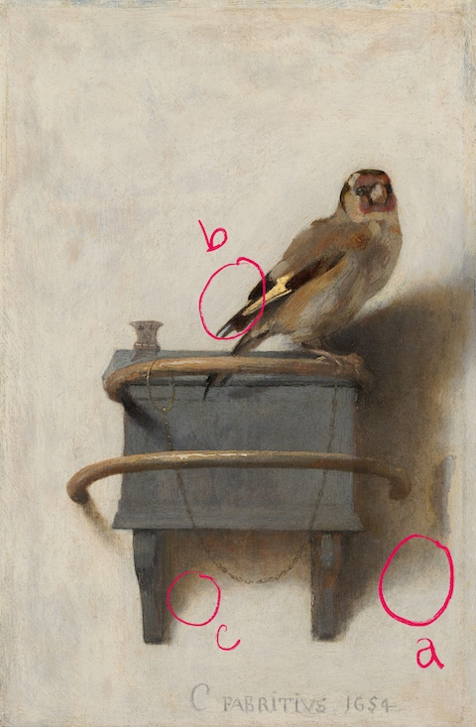
In this painting Goldfinch by Fabritius, you can see hard and soft edges.

Slide 14
Which letter is the hardest, crispist edge?

Slide 15
Which letter is the softest, fuzziest edge?

Slide 16
Which letter represents a medium soft edge?

Slide 17
Identifying lots of different kind of edges is even easier with an “edges scale”.

Slide 18
Let’s make one together!

Slide 19
Start by drawing a rectangle and dividing it in half. Make one half light and the other half dark.

Slide 20
Try to make the edge between light and dark as neat and clean and sharp as possible.

Slide 21
Now at the bottom of your page, add another rectangle. This time, transition from dark to light as slowly as possible.

Slide 22
Next, find the halfway edge between your sharpest and softest edges.

Slide 23
These 3 edges make great guideposts for finding the rest of the edges, which are more subtle.

Slide 24
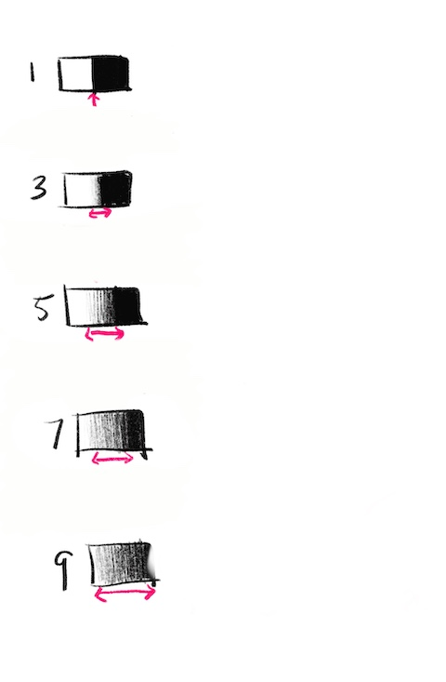
Now find the edges that are halfway between 1 & 5, and 5 & 9.

Slide 25
3 is just a little bit fuzzy.

Slide 26
Whereas 7 is quite a bit fuzzy.

Slide 27
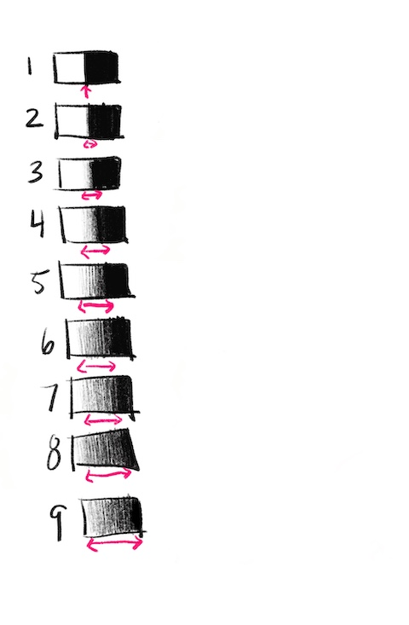
Now find all the in-between edges. This can be tricky, so take your time!

Slide 28
Check your work from top to bottom. Does every edge get fuzzier than the one before it?

Slide 29
Check your work from bottom to top. Does every edge get sharper than the one before it?

Slide 30
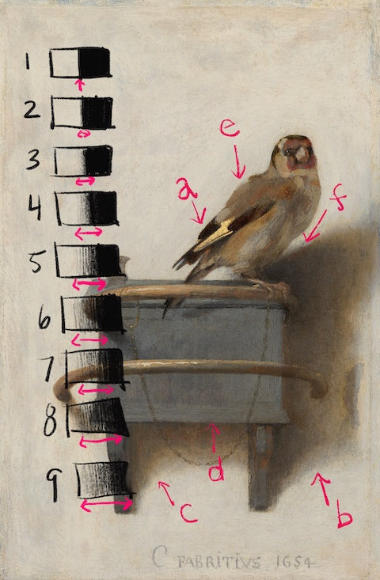
Let’s look at the Fabritius painting again.

Slide 31
Which numbers from the edge scale would you give each letter?

Slide 32
Answer Key
1
9
6
3
2
4

Slide 33
 | 2pts | 3pts | 4pts
Sharpest Edge | The transition between light and dark values is not crisp and clean. | The transition between light and dark values is mostly crisp and clean. | The transition between light and dark values is crisp and clean.
Softest Edge | The softest edge does not use the entire space to transition from light to dark. | The softest edge uses most of the space to transition from light to dark. | The softest edge uses the entire space to transition from light to dark.
In-Between Edges | Edges do not get continuously more fuzzy as the scale goes down the page. | Edges mostly continuously get more fuzzy as the scale goes down the page. | Edges continuously get more fuzzy as the scale goes down the page.

Slide 34
Resources
Join our popular Newsletter at www.schoolofatelierarts.com

Slide 35
Contact
Mandy Theis
admin@schoolofatelierarts.com
www.schoolofatelierarts.com
Join SAA’s newsletter for FREE LESSONS today!
Instagram
@mandyfineartist
@SchoolofAtelierArts

